Slide 1
TWITTER TRENDS ANALYSIS USING TOPIC MODELLING
ALEX MUIRURI MWANGI
KCA/16/03044
Supervisor
Dr. LUCY W. MBURU
Faculty of Computing & Information Management
KCA University

Slide 2
Background of the Study
Huge increase in the amount of textual data generated
6000 Tweets posted every second on average translating to 500M Tweets daily.
Twitter offers many opportunities for research in NLP and machine learning.
Topic models can help summarizing, exploring and indexing this text data
Notes:
Internet has led to an explosion in textual data.
Studying tweets can aid in breaking news detection, personalized messages recommendation, friends recommendation, sentiment analysis . E.t.c

Slide 3
Problem Statement
Microblogging messages are restricted in length e.g., between 140-280 characters for Twitter.
Obscure Language and grammar use
Short messages with little grammatical structure
Locale-specific references
Notes:
Improper punctuation and grammar, shortened words & urls
Posts allude to specific events and locations.

Slide 4
Problem Statement
Bag of words.
Latent Variables.
Representation in numeric vectors
Adaptability due to unsupervised nature
Notes:
Word order and syntactic structure ignored.
Infer hidden meanings in data, making them robust to handling acronyms, slang and other peculiarities
Makes then suitable for further analysis & visualizayion
Easily retrainable on other text

Slide 5
Main Objective
Implement a Topic Model (TM) for Twitter trending topics

Slide 6
Specific Objectives
Investigate how TM can be applied to Twitter Trending Topics
Establish the appropriate text preprocessing and TM algorithms to apply to Tweets.
Design and develop a TM
Test and Validate the TM

Slide 7
Motivation of Study
Twitter is an important communication tool for diverse users across the globe.
Social media can be used to infer user’s interest, model complex social relationships and identify developing news stories and topics

Slide 8
Siginificance of the Study
Social scientists
Companies
Government
Other researchers
Notes:
Amplify social science analysis through automated methods instead of manual methods.
Sieve through many posts in a short time to discover what customers are saying
Analyze posts on events of national siginificance & emergency situations – info about events places and people of siginificance
Know the best preprocessing and models for microblogs

Slide 9
Literature Review - Theoretical
Latent Dirichlet Allocation(Blei et al., 2003)
Dynamic Topic Model(Blei & Lafferty, 2006)
Correlated Topic Model(Blei & Lafferty, 2009.)
Author Topic Model(Rosen-Zvi, Griffiths, Steyvers, & Smyth, 2012)
Structural Topic Model(Margaret E. Roberts, Brandon M. Stewart, 2017)
Notes:
Two main approaches NLP & statistical based
Topic models find hidden topics within a document collection – statistical based – Bayesian model- works by identifying word co-occurrence patterns which are interpreted as topics.
LDA is a workhorse topic model
LSI(Deerwester et al., 1990) used SVD for dimensionality reduction – LSA – pLSI(hoffmann, 1999) added a probability component-LSA could not account for polysemy-multiple use of words in different contexts.
LDA introduced a probabilistic model at the document level coming up with a mixture model
Assume documents are a mixture of topics and topics are a mixture of words
Each topic consists of a unique combination of words
CTM uses a logistic normal distribution that accounts for covariance pattern among the topic propotions
DTM models evolution of topics with time
Author-topic model includes details about the author to compare authors and discover what different authors are interested in.
STM incorporates metadata about documents. Improves inference methods to make it suitable for advanced modelling and evaluation

Slide 10
Literature Review - Theoretical
Computational methods
Gibbs Sampling (Griffiths & Steyvers, 2004)
Variational Inference (Blei et al., 2003)
Notes:
Find the optimal model
Find the most efficient method to approximate the posterior
Uses MCMC to sample a sequence of dependent random variables for infrerence
Optimization problem. Uses KL(a way of comparing two probability distributions) divergence to estimate the posterior

Slide 11
Literature Review - Empirical
D. Blei & John, 2007 applied CTM to science aricles form JSTOR archive.
Rosen-Zvi et al., 2012 applied author topic model to NIPS dataset.
Roberts et al., 2014 used STM to analyze open-ended surveys
Sokolova et al., 2016 did topic modelling and event identification on Twitter data collected by the Umati project.
Notes:
CTM perfomed better than LDA
Illustrated top 10 words of a topic with the top 10 authors likely associated. They showed the identified authors are well known for the topics identified
Showed the model is better than human coding. Included respondent metadata.
Analyzed Gikomba data, Mandera data, Makaburi data, Mpeketoni data

Slide 12
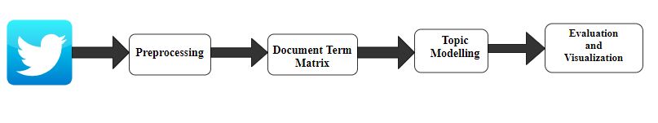
Research Methodology
Notes:
Data collected via Twitter API
DTM sparse matrix where documents are represented by rows and each unique word is represented by a column.

Slide 13
Research Methodology - preprocessing
Stopword removal
Stemming and lemmatization
Tokenization
Converting to lowercase
Notes:
removal of Twitter-specific features like hashtags, hyperlinks, emoticons, user mentions, slang and acronyms
Common words such as “and” and “the” that don’t contribute to the model
Remove endings of conjugated verbs and nouns leaving the stem. Lemmatization is a more advanced algorithm
Separating strings into words.
To standardize words to the same underlying concept.

Slide 14
Research Methodology - Analysis
Choosing parameters
Data Analysis
Model Evaluation
Notes:
K (number of topics) and alpha (affects how many topics a document can contain) Lower alpha leads to a higher concentration of topic distributions within documents.
STM package
Manual analysis and perplexity. Lower perplexity = better prediction

Slide 15
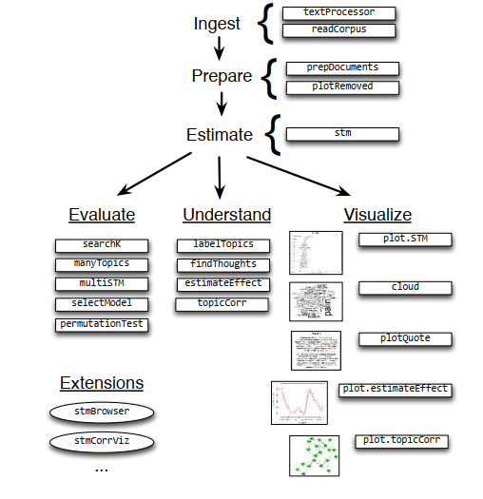
Functions within the stm package form Roberts et al. (2015)

Slide 16
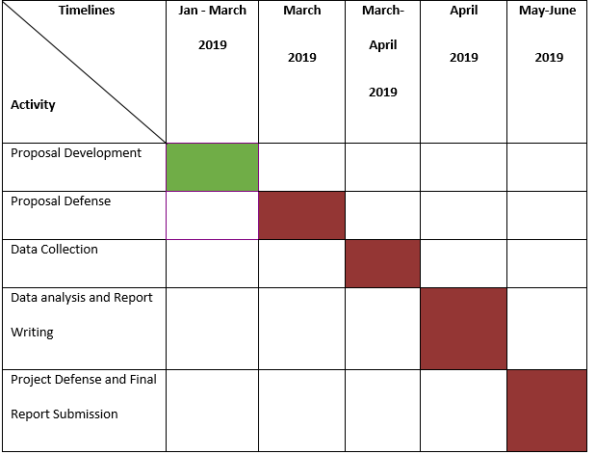
Research Schedule

Slide 17
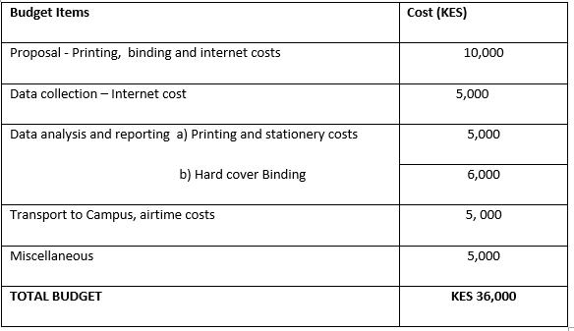
Budget

Slide 18
References
Manna, S., & Phongpanangam, O. (2018). Exploring Topic Models on Short Texts: A Case Study with Crisis Data. 2018 Second IEEE International Conference on Robotic Computing (IRC), 377-382.
Benhardus, J., & Kalita, J. (2013). Streaming trend detection in Twitter. International Journal of Web Based Communities, 9(1), 122. https://doi.org/10.1504/IJWBC.2013.051298
Bhattacharya, P., Ganguly, N., Ghosh, S., Zafar, M. B., & Gummadi, K. P. (2014). Inferring user interests in the Twitter social network, 357–360. https://doi.org/10.1145/2645710.2645765
Blei, D. M. (2012). Probabilistic Topic Models, 77–84.
Blei, D. M., Edu, B. B., Ng, A. Y., Edu, A. S., Jordan, M. I., & Edu, J. B. (2003). Latent Dirichlet Allocation. Journal of Machine Learning Research, 3, 993–1022. https://doi.org/10.1162/jmlr.2003.3.4-5.993
Blei, D. M., & Lafferty, J. D. (2006). Dynamic Topic Models.
Blei, D. M., & Lafferty, J. D. (2009). Topic models.
Deerwester, S., Furnas, G. W., Landauer, T. K., & Harshman, R. (1990). Indexing by Latent Semantic Analysis.

Slide 19
Eisenstein, J. (2013). What to do about bad language on the internet. NAACL HLT 2013 - 2013 Conference of the North American Chapter of the Association for Computational Linguistics: Human Language Technologies, Proceedings of the Main Conference, (June), 359–369. https://doi.org/10.1016/j.febslet.2009.03.055
Griffiths, T. L., & Steyvers, M. (2004). Finding scientific topics.
Hofmann, T. (2001). Unsupervised Learning by Probabilistic Latent Semantic Analysis, 177–196.
Jacobi, C., Van Atteveldt, W., & Welbers, K. (2016). Quantitative analysis of large amounts of journalistic texts using topic modelling. Digital Journalism, 4(1), 89–106. https://doi.org/10.1080/21670811.2015.1093271
Landauer, T. K., & Dutnais, S. T. (1997). A Solution to Plato ’ s Problem : The Latent Semantic Analysis Theory of Acquisition , Induction , and Representation of Knowledge, 1(2), 211–240.
Lda, T., & Ctm, T. (2007). A correlated topic model of, 1(1), 17–35. https://doi.org/10.1214/07-AOAS114
Lucas, C., Nielsen, R. A., Roberts, M. E., Stewart, B. M., Storer, A., & Tingley, D. (2015). Computer-assisted text analysis for comparative politics. Political Analysis, 23(2), 254–277. https://doi.org/10.1093/pan/mpu019

Slide 20
Margaret E. Roberts, Brandon M. Stewart, D. T. (2017). stm: R Package for Structural Topic Models, VV(Ii). https://doi.org/10.18637/jss.v000.i00
Reich, J., Tingley, D., Luis, J. L., Roberts, M. E., & Stewart, B. M. (2015). Computer-Assisted Reading and Discovery for Student-Generated Text in Massive Open Online Courses 1 OVERVIEW, 2, 156–184.
Roberts, M. E., Stewart, B. M., Tingley, D., Lucas, C., Leder-Luis, J., Gadarian, S. K., … Rand, D. G. (2014). Structural topic models for open-ended survey responses. American Journal of Political Science, 58(4), 1064–1082. https://doi.org/10.1111/ajps.12103
Rosen-Zvi, M., Griffiths, T., Steyvers, M., & Smyth, P. (2012). The Author-Topic Model for Authors and Documents, (January). Retrieved from http://arxiv.org/abs/1207.4169
Sokolova, M., Huang, K., Matwin, S., Ramisch, J., Sazonova, V., Black, R., Sambuli, N. (2016). Topic Modelling and Event Identification from Twitter Textual Data. arXiv Preprint arXiv:1608.02519, 17. Retrieved from http://arxiv.org/abs/1608.02519
Wesslen, R. (2018). Computer-Assisted Text Analysis for Social Science: Topic Models and Beyond. Retrieved from http://arxiv.org/abs/1803.11045

